Slide 1

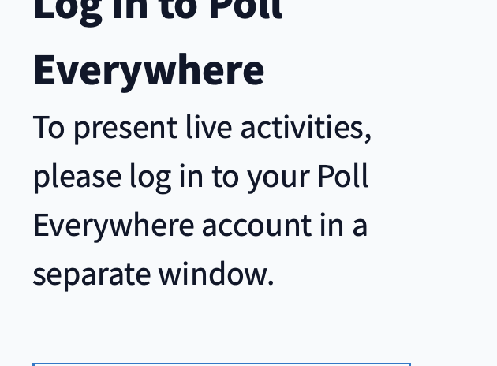
Branch and Bound for Piecewise Linear Neural Network Verification
Presentation By:
NeuroCop

Slide 2
Agenda
Introduction
Problem Specification
Verification Formalism
Branch and Bound for Verification
Improved BaB for NN Verification
Experimental Setup
Analysis
Conclusion

Slide 3
Agenda
Introduction
Problem Specification
Verification Formalism
Branch and Bound for Verification
Improved BaB for NN Verification
Experimental Setup
Analysis
Conclusion

Slide 4

INTRODUCTION
Despite their success in a wide variety of applications, Deep neural networks have seen limited adoption in safety-critical applications such as autonomous driving cars.
We know that the neural networks behave like a black box hence it is hard to verify them and proving or disproving them is basically proving if the NN satisfies certain input-output properties.
Only recently researchers have been successful in verifying some classes of models by exploiting their piecewise linear structure and taking insights from formal methods such as Satisifiability Modulo Theory .

Slide 5
Key Contributions
Introduced Bab Framework That takes advantage of the mixed INTEGER LINEAR PROGRAMMING.
Identified METHODS THAT COMBINE STRENGTHS AND WEAKNESS OF PREVIOUS Verification METHODS to compute bounds and branching STRATEGIES
Introduction of comprehensive dataset CONSISTING OF TRAINED AND SYNTHETIC NETWORKS WITH FULLY CONNECTED AND CONVOLUTIONAL LAYERS.

Slide 6
BOUND COMPUTATION
Bounds Computation: In the context of neural network verification, determining bounds is crucial. These bounds help in understanding the range of possible values that certain variables can take during the operation of the network. They have analyzed the strengths and weaknesses of previous verification methods in terms of how they computed these bounds.
Strengths: Some existing methods had effective techniques for computing bounds. These techniques could accurately estimate the possible ranges of values that network variables could take.
Weaknesses: On the other hand, certain methods had limitations in their bound computation. They might either be overly computationally expensive, particularly when dealing with high-dimensional input data, or ineffective, especially when applied to convolutional neural network architectures.
Aim is to learn from these strengths and weaknesses and develop improved methods that would address these issues.

Slide 7
Limitations of previous Branching Heuristics
Branching Strategies: Branching refers to the process of systematically exploring different parts of the neural network to verify its behavior. The previous verification methods, particularly those based on the Branch-and-Bound (BaB) framework, primarily focused on designing heuristics for branching over input domains.
Strengths: These heuristics often worked well for small-scale problems, providing a reasonable approach for exploring the network's behavior.
Weaknesses: However, these methods encountered challenges when applied to more complex, high-dimensional input problems or when dealing with convolutional network architectures. Similar issues were noticed with ReLU branching strategies, which are methods specifically designed to deal with networks using Rectified Linear Units.

Slide 8
BaB Branching Heuristic
New Branching Strategy: The paper introduces a novel branching strategy that is designed to be more efficient and effective, especially for networks with ReLU non-linearities. Here's how it differs from the existing strategies:
Efficiency: The new branching strategy is described as "computationally cheap," which means it doesn't require excessive computational resources.
Exploration of Network Architecture: Unlike some previous strategies that focused solely on input domains, the new approach takes into account the underlying architecture of the neural network. It examines how the network is structured to make branching decisions.

Slide 9
Compehensive Test Data
They have introduced data sets consisting of trained and synthetic networks with both fully connected and convolutional layers.
Role of Convolutional Networks: Convolutional networks are commonly used in computer vision tasks, and they are crucial for fair and comprehensive evaluations of verification methods. Inclusion of convolutional network data in verification evaluations is a recent development. These data sets aim to verify properties related to adversarial robustness in the presence of perturbations (changes) within a certain distance from the original data.
Variability in Verification Properties:
Epsilon: Firstly, the difficulty of a verification property not only relies on the size of the network, but also the value of ε. The data sets introduced here differ from previous ones by varying the range of perturbation values (represented as ε) on the same network. This variability in ε values allows for a more thorough understanding of how network behavior changes under different levels of perturbation.
LP Bottleneck: Secondly, one bottleneck for BaB based methods is the time required for solving linear programs (LPs), which could increase significantly with the size of the network. Our data sets consist of verification properties with various difficulty levels on relatively small network architecture. This means they allow effective evaluations of branching heuristics or bounding decisions without suffering from the LP bottleneck.
TwinStream Data Set: In addition to the main data sets, a synthetic data set called TwinStream is introduced. This data set is designed to help researchers study the relationship between bounding and branching strategies. It's a valuable resource for understanding how these strategies work together in the verification process.

Slide 10
Agenda
Introduction
Problem Specification
Verification Formalism
Branch and Bound for Verification
Improved BaB for NN Verification
Experimental Setup
Analysis
Conclusion

Slide 11

Problem Statement: The paper talks about the problem of formally verifying neural networks. In this context, formal verification means ensuring that a neural network behaves correctly in all cases
Given a neural network that implements a function with a bounded input domain C and property P
We have to prove:
You have a neural network that takes some input x0, and you want to prove that when x0 is within a certain range (bounded input domain C), the network's output, which we'll call ˆxn, satisfies a specific property P.

Slide 12


Example: Robustness to Adversarial
Here you want to check if the network is robust against changes in the input data . We have a training sample a with label y_{a}
The network can correctly classify it even when the input data is slightly altered (within a certain limit ε, defined as L∞ norm).

Slide 13
Agenda
Introduction
Problem Specification
Verification Formalism
Branch and Bound for Verification
Improved BaB for NN Verification
Experimental Setup
Analysis
Conclusion

Slide 14
Verification Formalism
Verification as a Satisfiability Problem: The paper introduces various methods that leverage the piecewise-linear structure of Piecewise-Linear Neural Networks (PL-NNs) to make the verification problem more manageable. These methods all share a common approach: given a property that needs to be proven they attempt to find a counterexample that would make the property false.
This is done by defining a set of variables representing the network's inputs, hidden units, and outputs, along with a set of constraints that a counterexample must satisfy.

Slide 15
Verification Formalism Contd..
To help design a unified framework, we reduce all instances of verification problems to a canonical representation
Transformed the satisfiability problem into a global optimization problem thus finding the optimal value for the specific mathematical function .And the decision will be obtained by checking the sign of the minimum .If global minima is greater than 0, property is true
On the other hand, if the global minimum is negative, then the property is false hence the minimizer provides a counter-example

Slide 16
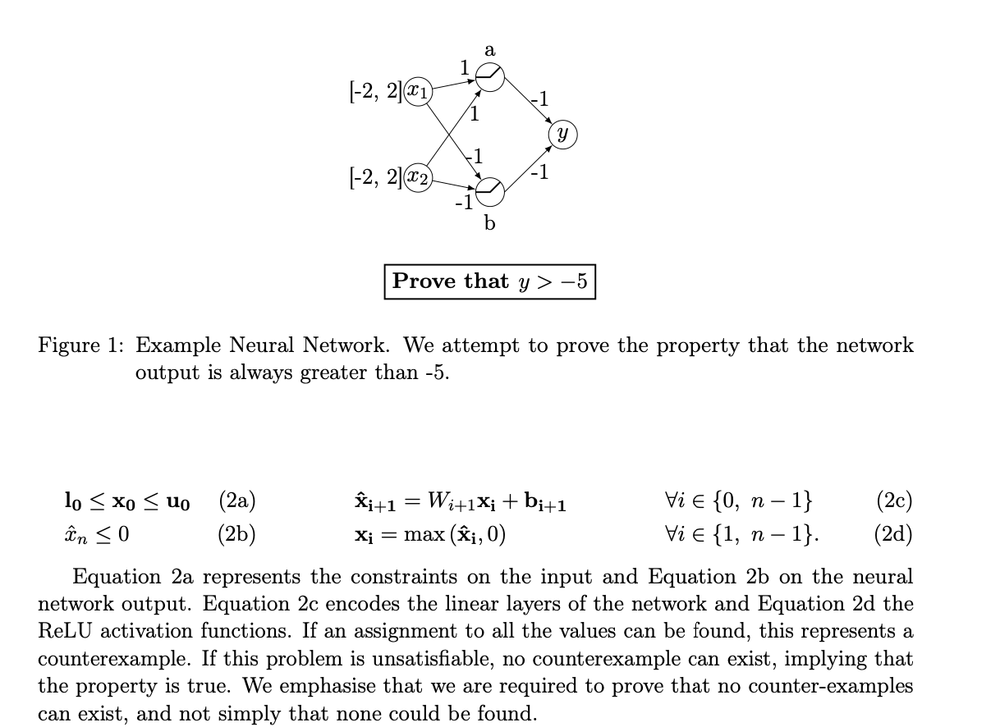
Toy Example

Slide 17
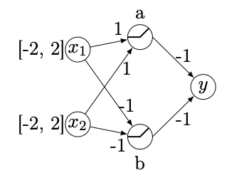
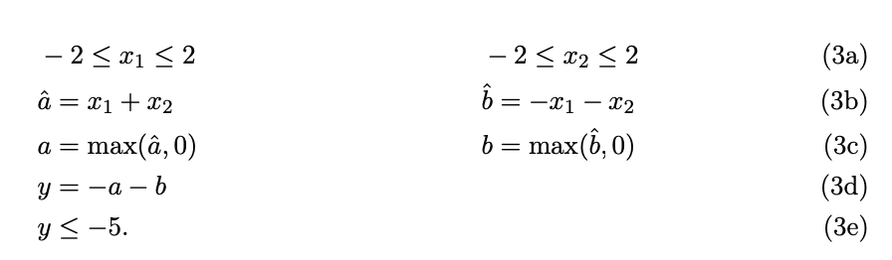
How BaB handles the Toy Example
Defining a set of variables representing the network's inputs, hidden units, and output: x₁,x₂,a_{in},a_{out},b_{in},b_{out},y
Define the constraints:

Slide 18
Mixed Integer Linear Programming Formulation
Paper is dealing with the verification of neural networks with non-linear activation functions. These non-linearities make the verification problem challenging. To simplify the problem, the paper suggests a method to replace these non-linearities with binary variables, turning it into a Mixed Integer Linear Programming (MIP) problem.
Assuming we have access to lower and upper bounds on the values that can be taken by the coordinates of xˆi, which we denote li and ui, we can replace the non-linearities:
The idea is to use binary variables (0 or 1) to represent whether certain values are turned on or off. Let's say we have a value xi, and we want to know if it's greater than or equal to 0. We can introduce a binary variable δi to represent this. If δi is 1, it means xi is turned on and greater than or equal to 0. If δi is 0, it means xi is turned off and not greater than 0

Slide 19
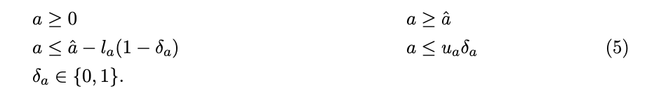
How Bab Handles MIP
Equation 3c of the Toy Example would be encoded as :
where la is a lower bound of the value that aˆ can take and ua is an upper bound. The binary variable δa indicates which phase the ReLU is in: if δa = 0, the ReLU is blocked and a = 0, else the ReLU is passing and a = aˆ. The problem remains difficult due to the integer constraint on δa.

Slide 20
Agenda
Introduction
Problem Specification
Verification Formalism
Branch and Bound for Verification
Improved BaB for NN Verification
Experimental Setup
Analysis
Conclusion

Slide 21
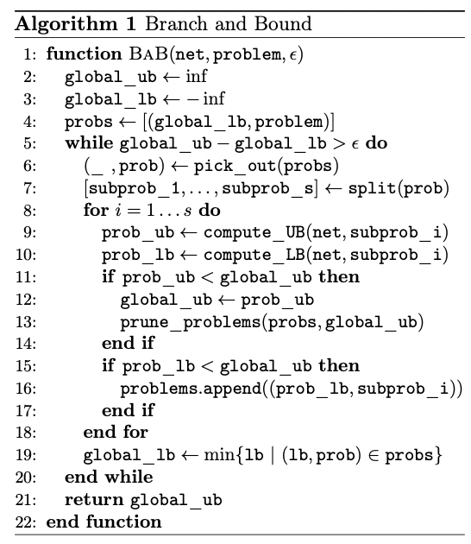
Branch and Bound for Verification
The verification problem can be rephrased as a global optimization problem
Seeks global solution(s) of a constrained optimization model
This paper will present an approach to estimate the global minimum, based on the Branch-and-Bound paradigm

Slide 22
Branch and Bound for Verification
A search strategy, defined by the pick_out function, which chooses the next problem to branch on

Slide 23
Branch and Bound for Verification
A branching rule, defined by the split function, which takes a problem prob and returns its partition into subproblems such that Ui subprob_i = prob and that (subprob_i ∩ subprob_j) = ∅, ∀i ̸= j.

Slide 24
Branch and Bound for Verification
Bounding methods, defined by the compute_{UB,LB} functions.
These procedures estimate respectively upper bounds (prob_ub) and lower bounds (prob_ub) over the minimum output that the network net can reach over a given (sub-)problem.

Slide 25
Branch and Bound for Verification
BaB Reformulations
ReluVal does not rely on SMT (Satisfiability modulo theories) Solvers
Reluplex and Planet depend on SMT Solvers
1) ReluVal
An input domain branching rule is used, and the split function decides which domain dimension to split on by computing influence metrics based on input-output gradient
For the bounding method, it uses a novel technique called symbolic interval propagation, which replaces lower and upper bounds by linear equations of input variables and propagates these linear equations in a layer-by-layer order
By doing so, symbolic intervals can preserve more dependency information than interval arithmetic, and are thus able to achieve tighter final bounds.

Slide 26
Branch and Bound for Verification
BaB Reformulations
ReluVal does not rely on SMT (Satisfiability modulo theories) Solvers
Reluplex and Planet depend on SMT Solvers
2) A Verification procedure via shadow prices
Inspired by the branching rule used by ReluVal, Royo et al. (2019) proposed a verification procedure via shadow prices. This method also adopts a Branch-and-Bound framework
For the branching rule, the method makes an input split decision through sensitivity studies of the bounds of unfixed ReLU nodes to the change of the input domain
The bounding method is not specified but the same logic has been used to check whether a sub-domain should be stored and further split on or should be pruned

Slide 27
Branch and Bound for Verification
BaB Reformulations
ReluVal does not rely on SMT (Satisfiability modulo theories) Solvers
Reluplex and Planet depend on SMT Solvers
3) Neurify
Neurify is an improved version of ReluVal, which also uses gradient metrics to make a split decision but it splits on unfixed ReLU nodes.
Neurify uses a different bounding method than ReluVal by calling an LP solver instead of computing symbolic interval bounds.
For all the methods mentioned, no specific search strategy is implemented. All sub-problems are simply enumerated.

Slide 28
Branch and Bound for Verification
Reluplex -> ReLU + Simplex Algorithm
Katz et al. (2017a) present a procedure named Reluplex to verify properties of a Neural Network containing linear functions and ReLU activation units
Reluplex functions as an SMT solver using the splitting-on-demand framework
The principle of Reluplex is to always maintain an assignment to all of the variables, even if some of the constraints are violated
Starting from an initial assignment, it attempts to fix some violated constraints at each step
It prioritizes fixing linear constraints using a simplex algorithm, even if it leads to violated ReLU constraints. If no solution to this relaxed problem containing only linear constraints exists, the counterexample search is unsatisfiable

Slide 29
Branch and Bound for Verification
Reluplex -> ReLU + Simplex Algorithm
Otherwise, either all ReLU are respected, which generates a counterexample, or Reluplex attempts to fix one of the violated ReLU, potentially leading to newly violated linear constraints. This process is not guaranteed to converge
Thus, to make progress, nonlinearities that get fixed too often are split into two cases. Two new problems are generated, each corresponding to one of the phases of the ReLU. In the worst setting, the problem will be split completely over all possible combinations of activation patterns, at which point the sub-problems will all be simple LPs
This algorithm is a special case of Branch-and-Bound for satisfiability

Slide 30
Branch and Bound for Verification
Reluplex -> ReLU + Simplex Algorithm
The search strategy is handled by the SMT core and to the best of our knowledge does not prioritize any (sub-)problems.
The branching rule is implemented by the ReLU-splitting procedure: when neither the upper bound search, nor the detection of infeasibility are successful, one non-linear constraint over the j-th neuron of the i-th layer xi[j] = max (xˆi[j], 0) is split out into two sub-problems: {xi[j] = 0, xˆi[j] ≤ 0} and {xi[j] = xˆi[j], xˆi[j] ≥ 0}.
As Reluplex only deals with satisfiability, the analogue of the lower bound computation is an over-approximation of the satisfiability problem

Slide 31
Branch and Bound for Verification
Reluplex -> ReLU + Simplex Algorithm
The bounding method used is a convex relaxation, obtained by dropping some of the constraints. The following relaxation is applied to ReLU units for which the sign of the input is unknown (li[j] ≤ 0 and ui[j] ≥ 0)
If this relaxation is unsatisfiable, this indicates that the subdomain cannot contain any counterexample and can be pruned out
The search for an assignment satisfying all the ReLU constraints by iteratively attempting to correct the violated ReLUs is a heuristic that is equivalent to the search for an upper bound lower than 0: success implies the end of the procedure.

Slide 32
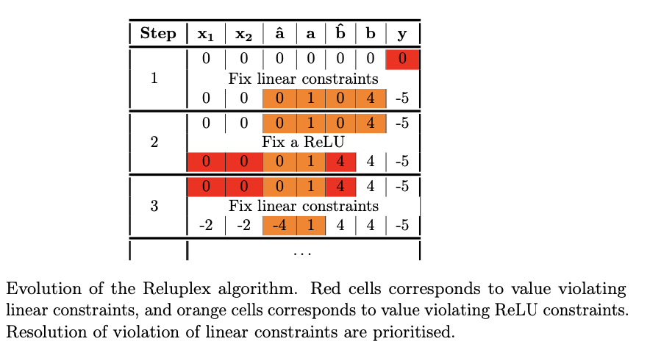
Branch and Bound for Verification

Slide 33
Branch and Bound for Verification
Planet
Ehlers (2017a) also proposed an approach based on SMT. Unlike Reluplex, the proposed tool, named Planet, operates by explicitly attempting to find an assignment to the phase of the non-linearities
It assigns a value of 0 or 1 to each δi[j] variable, verifying at each step the feasibility of the partial assignment so as to prune infeasible partial assignment early
As in Reluplex, the search strategy is not explicitly encoded and simply iterates over the (sub-) problems that have not yet been pruned
The branching rule is the same as for Reluplex, as fixing the decision variable δi[j] = 0 is equivalent to choosing {xi[j] = 0, xˆi[j] ≤ 0} and fixing δi[j] = 1 is equivalent to {xi[j] = xˆi[j], xˆi[j] ≥ 0}
Planet does not include any heuristic to prioritize which decision variables should be split over. As a result, there is no mechanism based on a heuristic search of a feasible point to encourage early termination in Planet

Slide 34
Branch and Bound for Verification
Planet
For satisfiable problems, only when a full complete assignment is identified is a solution returned. In order to detect incoherent assignments, Ehlers (2017a) introduces a global linear approximation to a neural network, which is used as a bounding method to over- approximate the set of values that each hidden unit can take.
In addition to the existing linear constraints, the non-linear constraints are approximated by sets of linear constraints representing the convex hull of each non-linearity treated independently.
Specifically, ReLUs with input of unknown sign are replaced by the set of equations:
xi[j] corresponds to the value of the j-th coordinate of xi.

Slide 35
Branch and Bound for Verification
Planet
Compared with the relaxation of Reluplex Equation 6, the Planet relaxation is tighter. Given that xˆi[j] is smaller than ui[j], the fraction multiplying ui[j] is necessarily smaller than 1, implying that this provides a tighter bounds on xi[j]
To use this approximation to compute better bounds than the ones given by simple interval arithmetic, it is possible to leverage the feed-forward structure of the neural networks and obtain bounds one layer at a time
Having included all the constraints up until the i-th layer (not including the i-th layer), it is possible to optimize over the resulting linear programming problem and obtain bounds for all the units of the i-th layer, which in turn will allow us to create the constraints Equation 7 for the next layer

Slide 36
Branch and Bound for Verification
Planet
In addition to the pruning obtained by the convex relaxation, both Planet and Reluplex make use of conflict analysis (Marques-Silva and Sakallah, 1999) to discover combinations of splits that cannot lead to satisfiable assignments, allowing them to perform further pruning of (sub-)problems.

Slide 37
Agenda
Introduction
Problem Specification
Verification Formalism
Branch and Bound for Verification
Improved BaB for NN Verification
Experimental Setup
Analysis
Conclusion

Slide 38
Improved BaB for NN Verification
Previous approaches to neural network verification have relied on methodologies developed in three communities:
Optimization, for the estimation of upper and lower bounds;
Verification, especially SMT; and
Machine learning, especially the feed-forward nature of neural networks for the creation of relaxations
“Can other existing literature from these domains be exploited to further improve neural network verification?”
Our Branch-and-Bound framework makes it easy to answer this question. With its help, we can easily identify and consequently provide a non-exhaustive list of techniques to speed-up verification algorithms

Slide 39
Improved BaB for NN Verification
Better Bounding
While the relaxation proposed by Ehlers (2017a) is tighter than the one used by Reluplex, it can be improved further still
Specifically, after a splitting operation, on a newly generated (sub-)problem, we can refine all the li,ui bounds by, for instance, formulating corresponding linear programming problems with added constraints from the split
Then, we solve for the minimum for li[j] and maximum for ui[j]
With refined upper and lower bounds, we are able to introduce smaller convex relaxation hulls to obtain tighter relaxations

Slide 40
Improved BaB for NN Verification
Better Bounding
However, it should be noted there is a trade-off between the benefits of tighter relaxation and the overall computational efficiency
Since updating all the li,ui bounds could be computationally expensive, we also show in the experiments section that, depending on the problem at hand, it is sometimes sufficient to update bounds for some of the layers
The overall gain from a tighter relaxation is not in a linear relationship with the number of intermediate bounds updated

Slide 41
Improved BaB for NN Verification
Better Branching
We now discuss two possible ways to improve branching strategies:
Branching on Input Domains
Branching on ReLU Activation Nodes

Slide 42
Improved BaB for NN Verification
Better Branching
Branching on Input Domains
Planet and Reluplex methods ignore another natural branching strategy, namely, splitting on the input domain
There are two main advantages of input domain splitting strategies:
It is simple and straightforward to apply. Once an input dimension to split on is decided, we only need to modify the associated input constraints for each sub-domain, generated by the split step of the BaB algorithm. There is no need to deal with potential conflicts (e.g. infeasible sub-problem) that could be introduced by fixing a ReLU node
It can be argued that since the function encoded by the neural networks are piecewise linear in their input, splitting the input domain could result in the computation of high quality upper and lower bounds. With tighter input bounds, tighter intermediate bounds at all layers can be easily re-evaluated, which might not be the case for splitting on a ReLU node, at least for layers prior to the ReLU node we branch on.

Slide 43
Improved BaB for NN Verification
Better Branching
Branching on Input Domains
To demonstrate the benefits of input domain splitting, we propose two novel input split algorithms. The first and the most direct algorithm is the BaB algorithm.
Based on a domain with input constrained by equation l0 ≤x0 ≤u0 , the split function would return two subdomains where bounds would be identical in all dimension except for the dimension with the largest length, denoted i⋆. The bounds for each subdomain for dimension i⋆ are given by l0[i⋆] ≤ x0[i⋆] ≤ (l0[i⋆]+u0[i⋆])/2 and (l0[i⋆]+u0[i⋆])/2 ≤ x0[i⋆] ≤ u0[i⋆]
In order to exploit the benefits of input domain splitting to the fullest, we introduce the second splitting heuristic by using the highly efficient lower bound computation approach of Wong and Kolter (2018). This approach was initially proposed in the context of robust optimization. However, our unified framework opens the door for its use in verification. We propose a smart branching method BaBSB to replace the longest edge heuristic of BaB

Slide 44
Improved BaB for NN Verification
Better Branching
- Branching on ReLU Activation Nodes
Despite their success in small-scale verification problems, input domain splitting methods are often found to be inadequate for large scale networks, as there are several limitations of input domain branching strategies.
Firstly, for some methods (e.g. BaBSB), their computation cost for making a branching decision increases at least linearly with input dimensions. High computational cost renders these methods infeasible for high input dimensional problems.

Slide 45
Improved BaB for NN Verification
Better Branching
- Branching on ReLU Activation Nodes
Secondly and more importantly, potential input branching decisions constitute a fairly small portion of all potential branching decisions for large-scale network architecture, which contains a sizable number of unfixed ReLU activation nodes (each is a valid potential branching point).
Focusing on input domain splitting alone significantly limits the power of verification methods. Given the wide and almost dominant usage of deep convolutional networks in various tasks, developing an effective and computationally cheap heuristic for branching on ReLU non-linearities is of considerable importance for verification.
We propose a new smart branching algorithm BaBSR on the activation of the ReLU non-linearities.

Slide 46
Improved BaB for NN Verification
Better Branching
- Branching on ReLU Activation Nodes
Existing ReLU node splitting methods are Reluplex, Planet and Neurify. We show that BaBSR enjoys various benefits over the existing methods, although all methods use the same branching rule: for a given ReLU node (a node xi[j] = max 􏰁xˆi[j], 0􏰂 is split out into two subdomains:{xi[j] = 0, xˆi[j] ≤ 0} and {xi[j] = xˆi[j], xˆi[j] ≥ 0}).
To start, unlike Planet which does not have any heuristic to make splitting decisions, BaBSR uses a simple and fast heuristic to prioritize which unfixed ReLU node to split on.
Reluplex uses the SMT core to handle the splitting order and Neurify computes gradient scores to prioritize ReLU nodes. We show in experiments that the prioritizing strategy of BaBSR is much more successful than that of Reluplex and Neurify in selecting an effective ReLU node. Additionally, BaBSR has a convergence guarantee and encourages early termination, which means verification problems can be solved completely and efficiently.

Slide 47
Agenda
Introduction
Problem Specification
Verification Formalism
Branch and Bound for Verification
Improved BaB for NN Verification
Experimental Setup
Analysis
Conclusion

Slide 48
METHODS FOR SOLVING OPTIMIZATION PROBLEM
Black Box
Simple and straightforward app
Encodes the problem by sending the equation into the Gurobi solver.
Relies on Gurobi's own capabilities of problem solving with exploring any insights of the problem.
2. SMT based methods
'Reluplex' and 'Planet' tools in this framework are used for neural network verification.
Implemented in C++.
They also used the Gurobi Linear Programming solver.

Slide 49
3. MIP Solvers
Uses mixed integer programming – deals with problems involving both continuous and discreate variables.
Because of unavailability of open-source methods, researchers implemented their own MIP solver in Python.
This was names as 'MIPplanet'.
Interrupts the optimization problem once a negative value is found.
4. Pick_out Strategy
An approach for managing and prioritizing subproblems within the optimization process.
These subproblems may arise when dealing with complex systems like neural networks.
primary idea behind the pick_out strategy is to prioritize the subproblem that currently has the smallest lower bound.
Upper bounds are selected by random sampling.
Researches rebuild the approximations for each sub problem done using the LP solver to recompute the bounds.
Decision for rebuilding the approximation is based on factors like the size of the network architecture, number of input dimensions, and the characteristics of the layer weights.

Slide 50
TECHNIQUES FOR SPLITTING
Input Domain Split
the input space, where the neural network receives its input data, is divided or split into smaller regions.
Each subregion represents a portion of the input space.
This is often used in verification to explore and analyze how the network behaves in different regions of the input space.
Example: BaB

Slide 51
2. ReLU Activation Split
The focus is on splitting the problem based on the ReLU activation nodes within the network.
These nodes determine whether the output of the activation is positive or zero.
Exploring different activation patterns or conditions to analyze how the network responds to changes in the activation functions.
Example: BaBSR

Slide 52
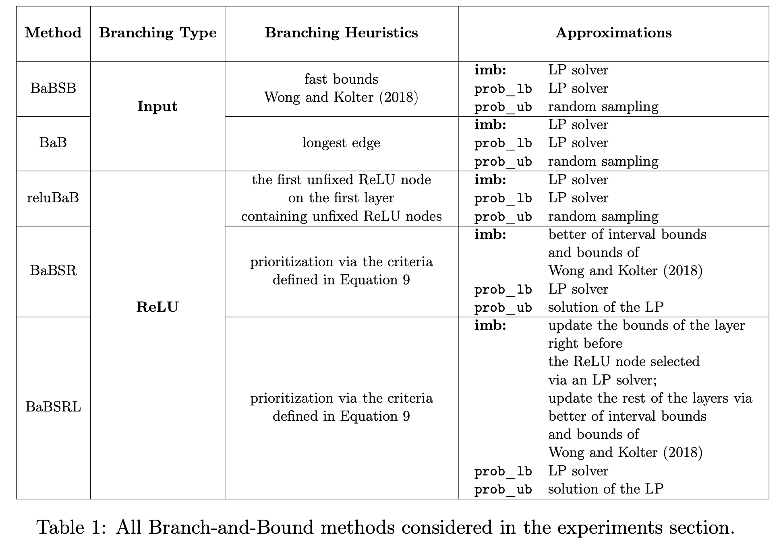

Slide 53
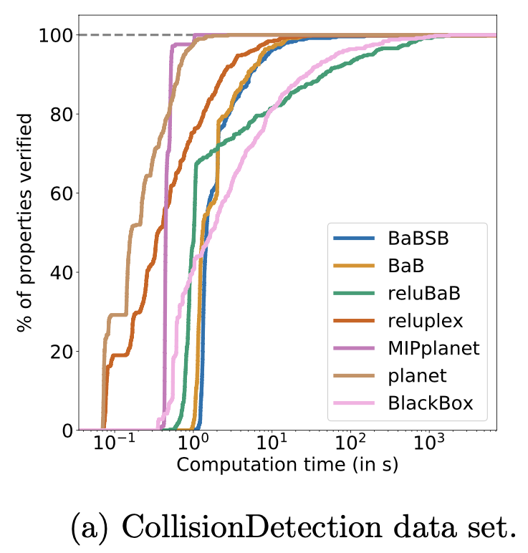
DATA SETS
Performing verification on datasets of properties and comparing results.
Collision Detection
Data set has 500 extracted properties derived from binary search process.
The Neural network used here is shallow.
Satisfiable (SAT) - properties for which a counterexample can be found, meaning prediction is false and collision happened.
The accuracy of these methods is a measure of how well they perform in correctly predicting whether collisions will occur or not.

Slide 54
2. Airborne Collision Avoidance System (ACAS)
Used for aviation safety – recommends horizontal manoeuvers to avoid collisions.
Dataset has 188 properties to be verified.
NN assigns a score to each of the 5-horizontal series of moves. Score determines effectiveness of each path.
The path with minimum score is considered as the most suitable action to take.
NN is deeper which results in scalability challenges on various methods.
3. Robust MNIST Network
NN consists of 2 convolution layers and 2 fully connected layers resulting in 4804 activation nodes.
Verification challenge - to verify the network's robustness.
Involves evaluating whether the predicted label for each input image changes when the image is perturbed within a specific ε-infinity norm ball.
This disturbances assesses how resilient the network's predictions are to slight variations in the input images.

Slide 55
4. Reduced Robust MNIST Network
It is used to assess the effectiveness of a particular branching heuristic.
It has fewer hidden nodes in each hidden layer, resulting in a total of 1226 ReLU nodes.
Verification challenge - to verify the networks robustness.
A larger ε value implies a more significant disturbance of the input image.
Higher ε value means the network is expected to be more robust.
5. PCAMNIST and TWINSTREAM
Used for extensive evaluation of verification methods & address the limitations of existing datasets.
PCAMNIST - evaluating methods of different network architectures - number of hidden units in each layer, and input dimensionality
TWINSTREAM - create a scenario where hidden nodes on the same layer are highly correlated.
Explores the tradeoffs between different bounding strategies in the context of hidden nodes.

Slide 56
Agenda
Introduction
Problem Specification
Verification Formalism
Branch and Bound for Verification
Improved BaB for NN Verification
Experimental Setup
Analysis
Conclusion

Slide 57
SMALL NETWORKS
Some factors to consider when using small networks.
Less number of neurons in the neural network.
Computationally feasible to compute all intermediate bounds using LP solver.
Intermediate bounds - helps to access reliability and robustness.
Tighter relaxations - more accurate and reliable bounds, which are crucial for achieving optimal performance in verification tasks.
Example : Collision detection dataset & ACAS dataset

Slide 58
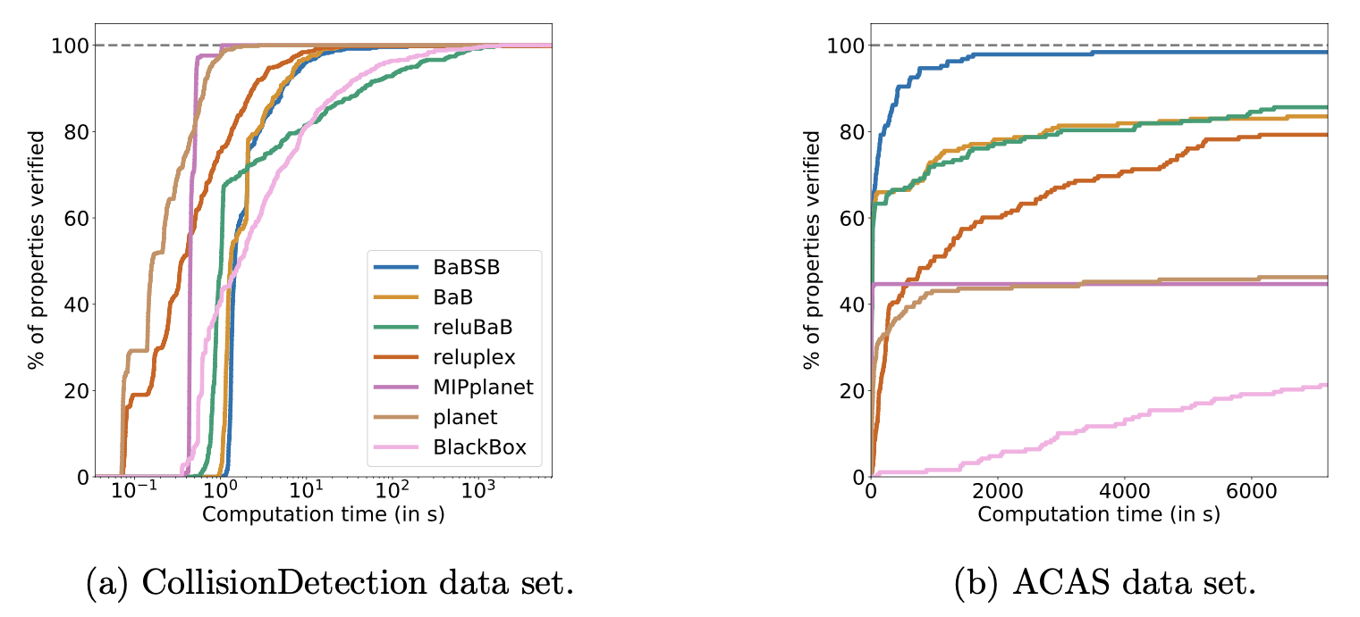

Slide 59
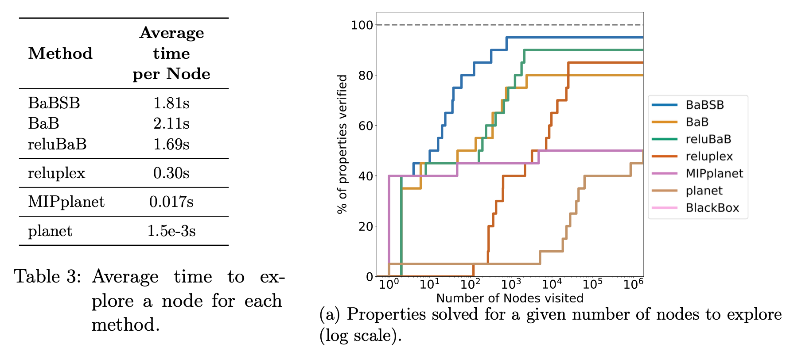
Additional analysis on ACAS dataset with 20 property subset.

Slide 60
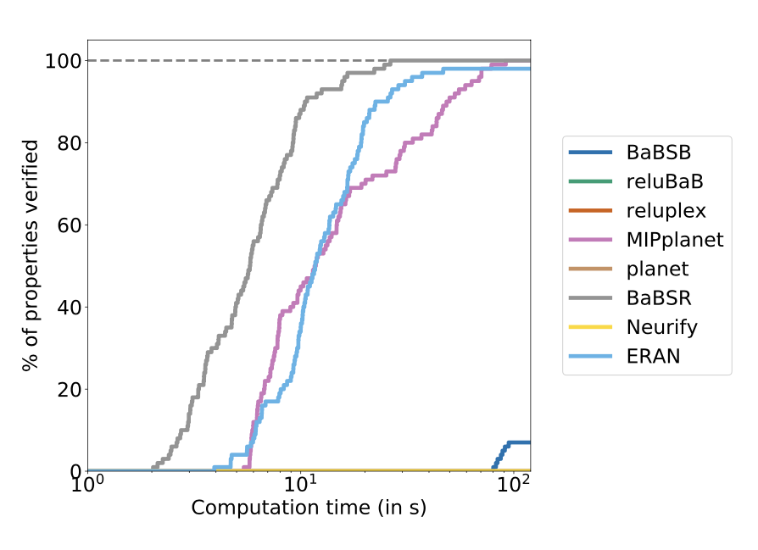
LARGE NETWORKS

Slide 61
CONCLUSION
Analyzing and improving the existing methods of verification of branch and bound.
Highlights new methods have shown significant performance improvements on comprehensive datasets.
Improvement areas – bound strategies - proposes using GPU (Graphics Processing Unit) computing power to calculate these tighter intermediate bounds more efficiently.
Another area for refinement - branching strategies – use the traditional heuristic method.
Introduced the graph neural network to improve adaptability but it comes with high offline costs.
The process of solving LP problems is a significant limiting factor or constraint that slows down the overall performance and efficiency of these methods.

Slide 62


Slide 63


